Slide 1



UNIT 4: So much to do, so little time
It’s Monday again

Slide 2

Can you name the days of the week?
What’s your favourite day of the week?

Slide 3
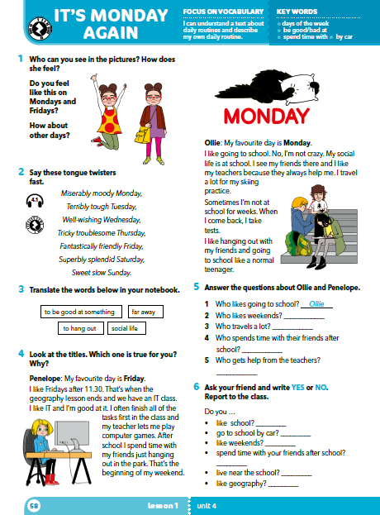

Do you feel like this on Mondays and Fridays?
How about other days?
How does Jinx feel about Monday?
On Mondays =
svaki ponedjeljak, ponedjeljkom

Slide 4
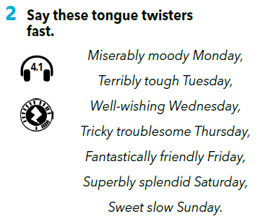

Translate
moody =
terribly tough =
well-wishing = troublesome =
superb; splendid =
ćudljiv, neraspoložen
nevjerojatno težak
koji želi dobro
problematičan
veličanstven, divan
https://www.e-sfera.hr/dodatni-digitalni-sadrzaji/cb39a5b8-d498-4acc-a12e-dd2356eda0da/assets/audio/28_tongue_twister.mp3

Slide 5
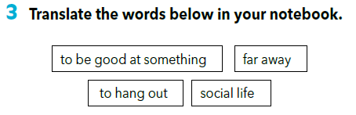
to be good at something = far away =
to hang out =
social life =
biti dobar u nečemu
daleko
družiti se
društveni život
Use these words and write the sentences on your own.

Slide 6
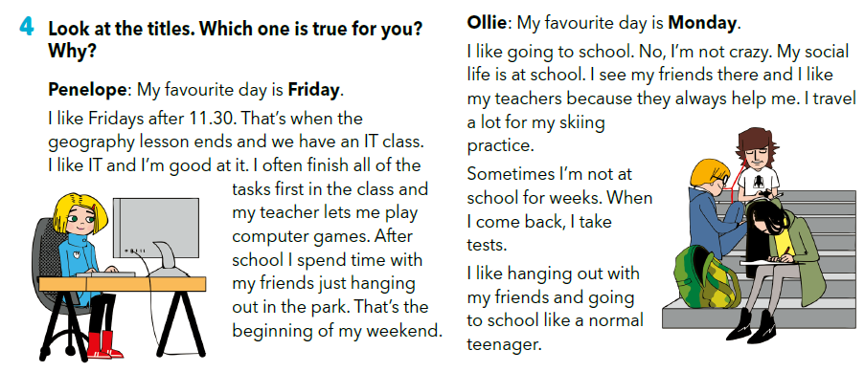
What is your favourite day: Friday or Monday? Why?

Slide 7
Read the texts and answer the questions.
Why does Penelope like Fridays?
Why does Ollie like Mondays?

Slide 8
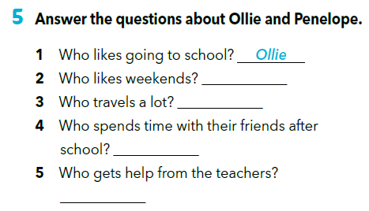
Read the texts again and answer the questions about Ollie and Penelope.
Penelope
Ollie
Penelope
Ollie

Slide 9
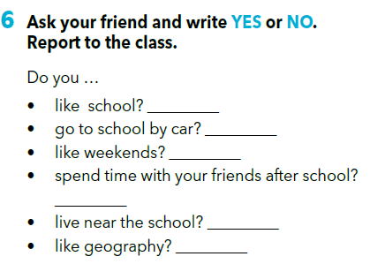

Slide 10
I travel a lot.
Ollie travels a lot.
We go to school by car.
Penelope goes to school by car.
→
I don’t travel a lot.
→
Ollie doesn’t travel a lot.
→
We don’t go to school by car.
→
Penelope doesn’t go to school by car.

Slide 11
Let’s practise!
I
You
We
They
He
She
It
play
I
You
We
They
He
She
It
don’t play
play
don’t play
(play) computer
games.
don’t play
computer games.
play
play
don’t play
plays
doesn’t play
plays
(play) computer
games.
doesn’t play
computer games.
plays
doesn’t play

Slide 12
Example:
He/She likes school.
He/She doesn’t go to school by car.

Slide 13
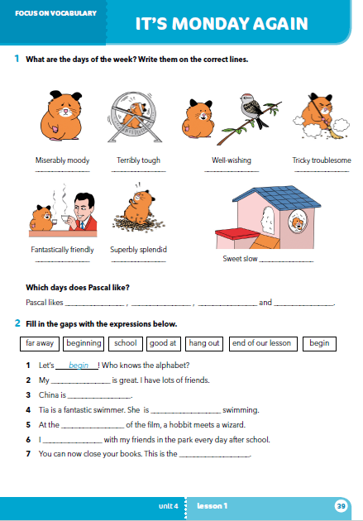
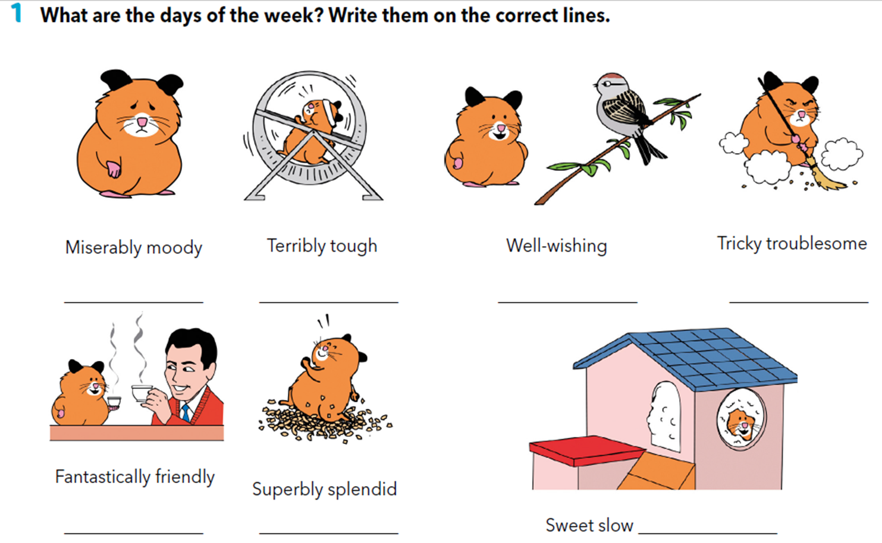
Workbook p 39.
Monday
Tuesday
Wednesday
Thursday
Friday
Saturday
Sunday

Slide 14
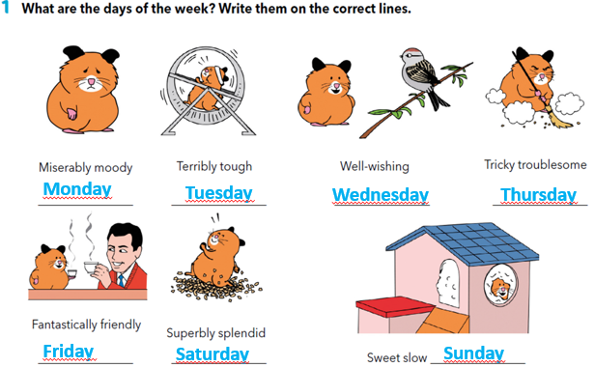
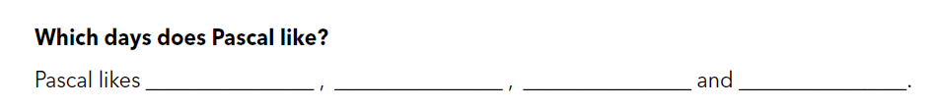
Wednesdays
Fridays
Saturdays
Sundays

Slide 15
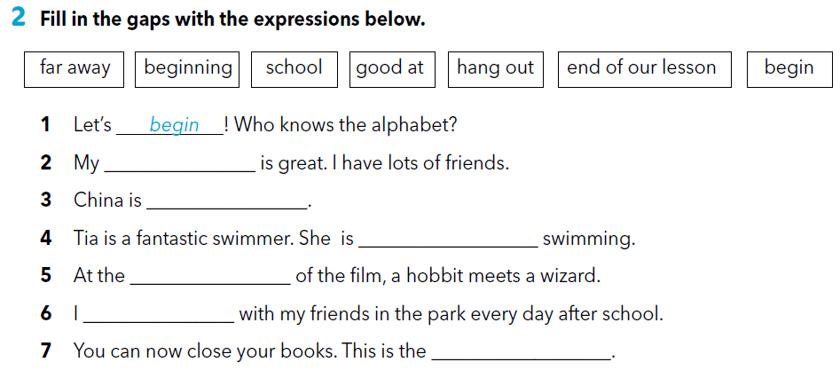
school
far away
good at
beginning
hang out
end of our lesson

Slide 16

Unscramble the tongue twisters.
https://wordwall.net/resource/256587/can-you-unscramble-these-tongue-twisters
SELF CHECK.
https://www.e-sfera.hr/dodatni-digitalni-sadrzaji/cb39a5b8-d498-4acc-a12e-dd2356eda0da/

Slide 17
Klikni na sljedeću poveznicu i odaberi LEARN MORE.
https://www.e-sfera.hr/dodatni-digitalni-sadrzaji/cb39a5b8-d498-4acc-a12e-dd2356eda0da/
Days of the week
Read the text and complete the task below.
Pročitaj tekst i riješi pripadajući zadatak

